Slide 1

Period End Closing Key Process Areas and New Period End Checks
Branded WBS Settlement
Above Brand Contribution (ABC)
WBS Settlement / Allocation
Multi-brand WBS Settlement / Allocation
Cost Management Closing Activities
Cost Center Distribution and Assessment
Internal Order Settlement (Leaf entities only)

Slide 2
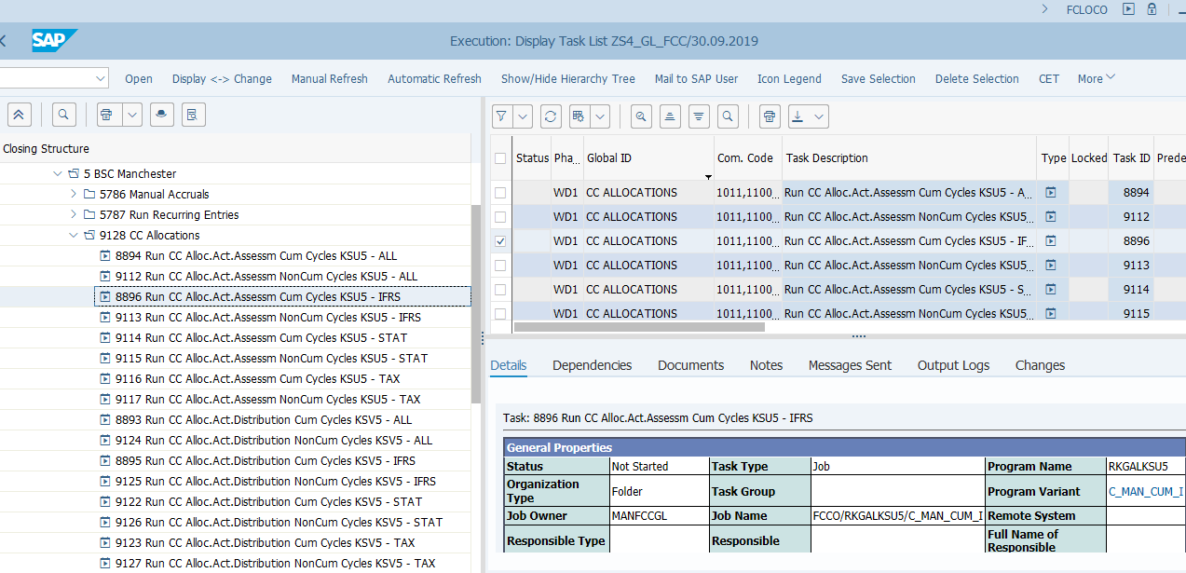
Cost Center Allocations
Basic Process of Cost Center Allocations
Costs are collected in Cost Centers during the month.
Distribution *
Costs recorded in Cost Centers
Postings are made using the original G/L accounts where the sender costs are recorded
These can be posted through Purchase Order Goods Receipts/Invoice Receipts, sundry invoices, miscellaneous charges (e.g. bank fee) and various expenses posted either via interfaces or direct FI journals, all to cost centers.
As different cost center allocation cycles can be run in sequence, some cost centers may have received costs from a previous cost center allocation.
Assessment *
Postings are made using secondary cost elements which are not the original G/L accounts where the sender costs are recorded
* Distribution and Assessment Cycles must be created before execution
T-Code:
KSV5 – Distribution
KSU5 – Assessment
The period end Cost Center Allocation tasks allocate costs from sender cost centers to receiver cost centers either by using the method of Distribution or Assessment. See details in Controlling Cost Center Allocations course.
These functionalities have not changed from ECC to S/4 HANA, however you can now indicate in the Cost Center Allocation cycles the ledger in which you want the allocation to take place. Separate FCC tasks are created for each ledger.
FCC Task:
GBS/JTBC and Entity Level
The schedule of execution of Cost Center Allocation cycles is controlled via the maintenance of cycle run groups in each cycle which are then linked to a respective task in FCC. Some cycles need be executed at specific times or in specific sequences (e.g. Intercompany related cycles). These are set up as entity level tasks in FCC.
Timing:
WD1, with some exceptions
Most of the Cost Center Distribution and Assessment cycles will be run on WD1 so that the cost center positions are finalized for further closing tasks to continue. There are some exceptions at certain entity level.

Slide 3
Cost Center Distribution and Assessment Illustration
Distribution (KSV5) – The same underlying account is used to perform the allocation. Receiving cost center owner is accountable for the costs
Assessment(KSU5) – A secondary cost account is used, therefore the costs are still visible on the original account and only the cost centers are impacted. Sending cost center owner is accountable for the costs
Distribution
Assessment
Cost Center A
Cost Center B
Cost Center A
Cost Center B
Account
511310 100 USD
Account
511310 -30 USD
Account
511310 30 USD
Account
511310 100 USD
Account
920000 -30 USD
Account
920000 30 USD
Allocation
Allocation
3

Slide 4
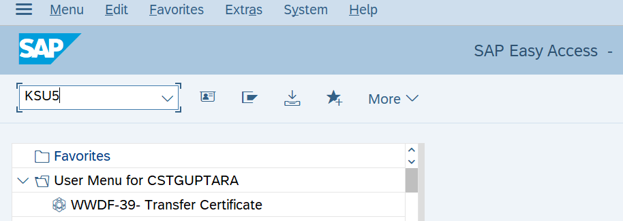
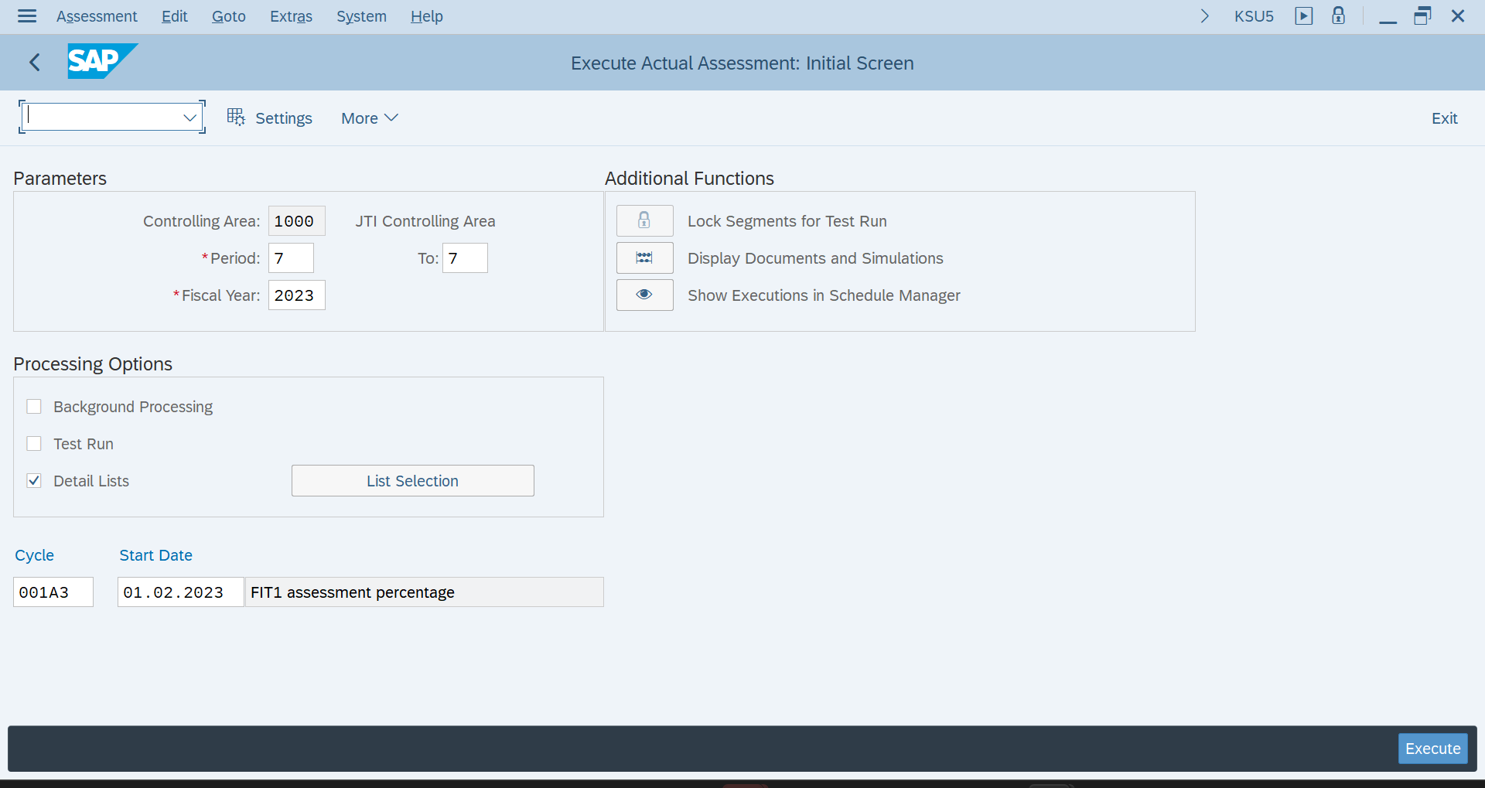
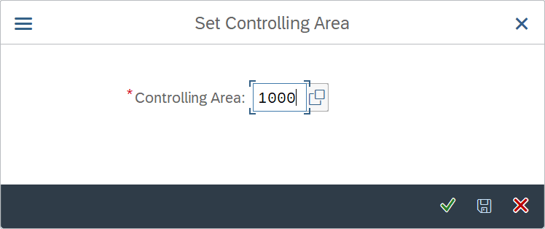
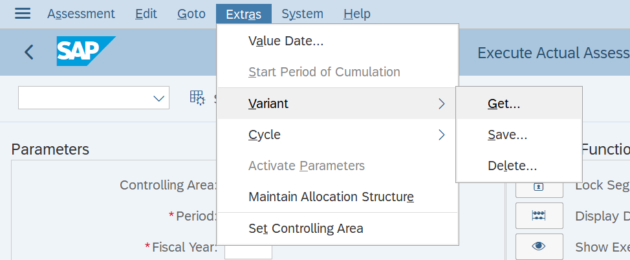
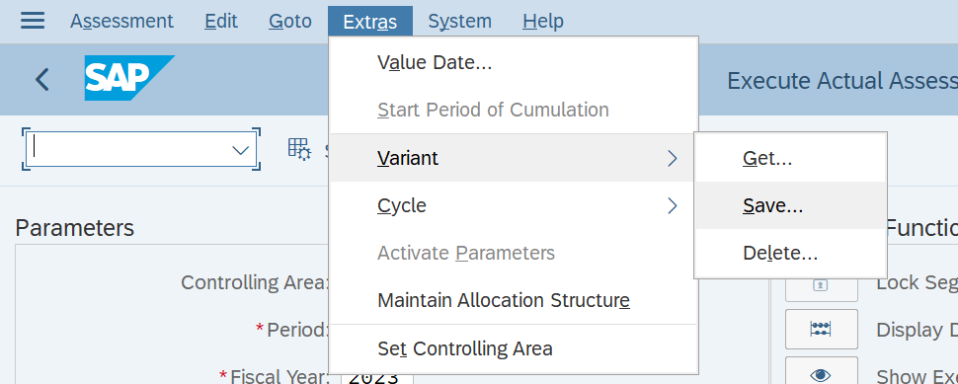
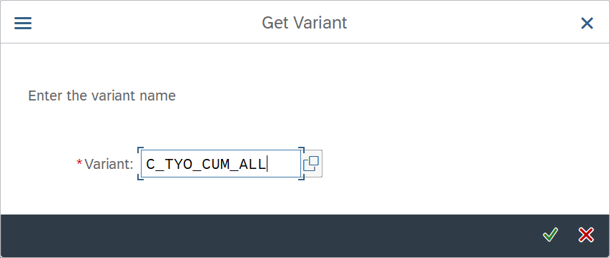
Cost Center Allocations FCC variants update for cycles
1. Execute T-Code : KSU5
5. Enter the “Cycle” name
2. Enter “Controlling Area”: 1000
3. Go to Menu bar: Select Extras-Variant-Get…
6. Go to Menu bar: Select Extras-Variant-Save…
4. Enter the “Variant” where you want to update the cycle.

Slide 5
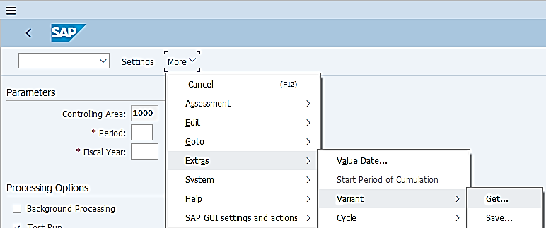
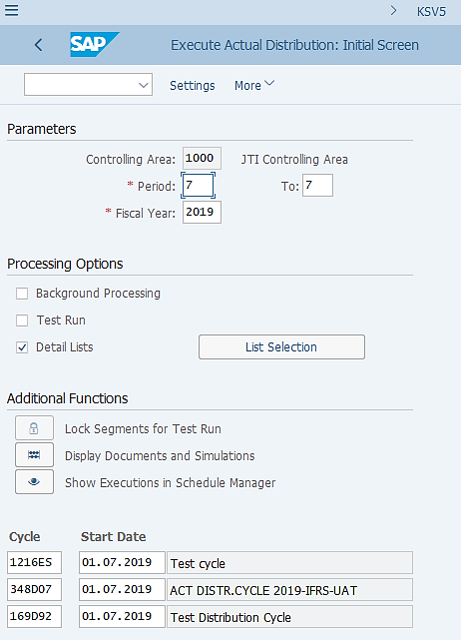
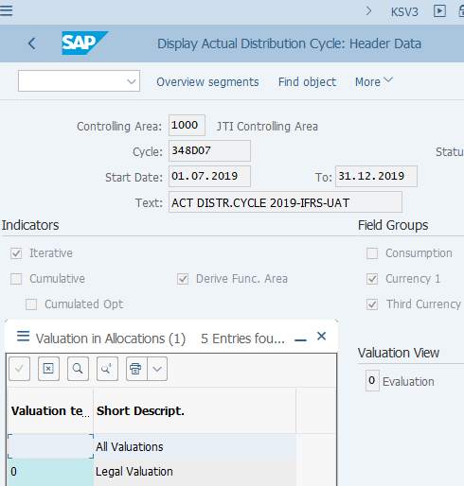
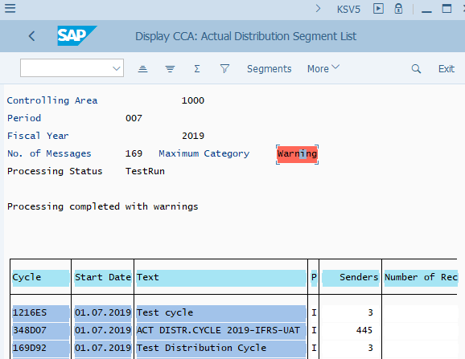
Cost Center Allocation: Distribution
KSV5: Cost Center Distribution Execution
KSV3: Display Distribution Cycle
Cost Center Allocation variants do not use standard or custom variables. But you should check if the cycles included are still valid when used outside of FCC.
Cost Center Distribution (KSV5) :
If you need to run Cost Center Distribution cycles outside of FCC, make sure you use the corresponding variant as indicated in the corresponding FCC task.
The variants are updated by GBS/JTBC when there are such requests from entities.
Cycles with the same allocation type (Distribution or Assessment), cumulative indicator (Cumulative indicator set or not set) and valuation view (indicating the posting to which ledger) settings are included in the same variant.
KSV5 output upon execution
In the master data of each cost center allocation cycle, the “Valuation View” indicates in which ledger the cycle is going to be run. For further details refer to Cost Center Allocation course.
It is recommended that you Test Run the cycle first if you are doing it outside of FCC so that you can review the messages and make amendments if needed before update run. You may display the segments/sender/receiver details using the corresponding buttons.
When you do an update run you will be provided with the posted document numbers for cycles with no errors in the output log (same as what you will find in an executed FCC task).

Slide 6
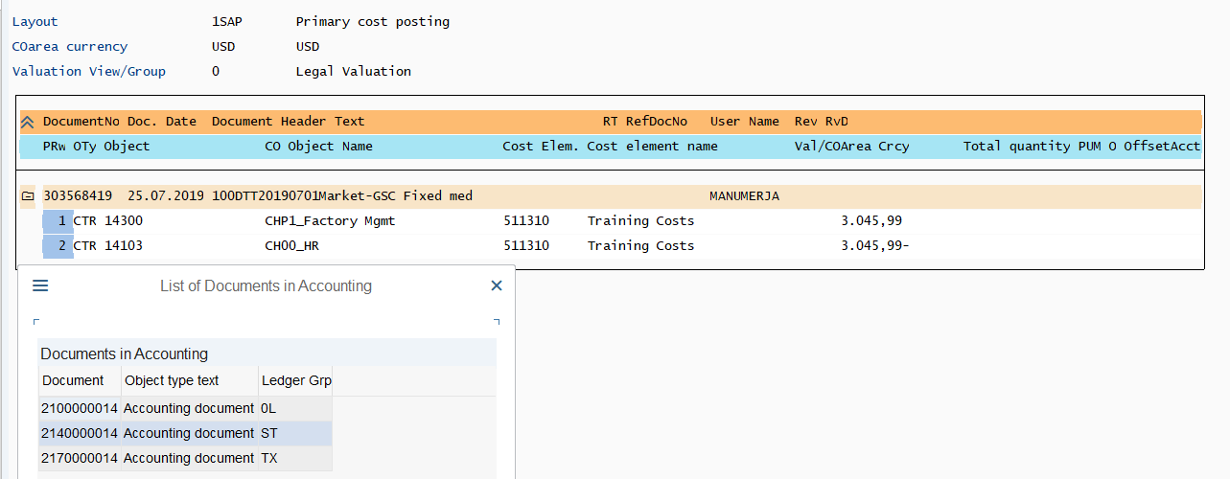
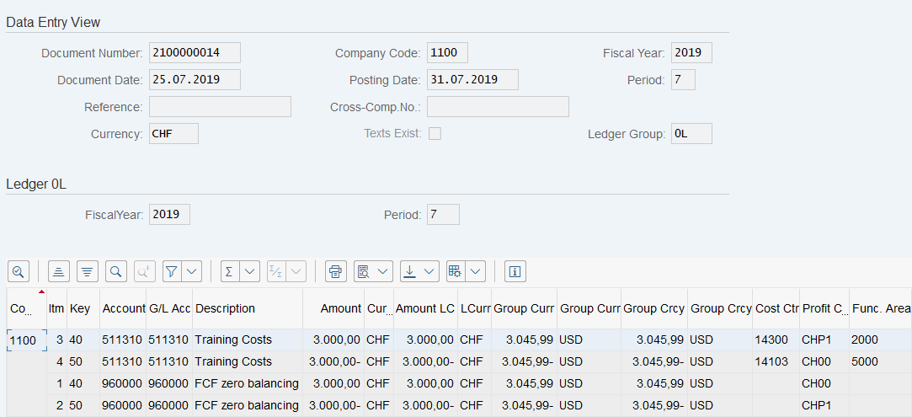
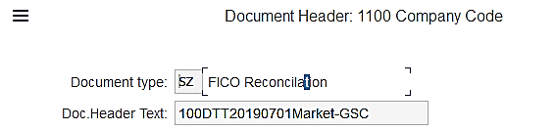
Cost Center Distribution: Posting Example
Cost Center Allocations generate Accounting documents in FI in S/4HANA Universal Journal environment.
The postings can be made to all or selected ledgers based on the Valuation View defined in Cost Center Allocation cycles.
Each Accounting Document is posted to one ledger only (as shown in this example), and such documents do not have Data Entry View, i.e. you can’t switch between Entry View and Ledger View as other Accounting Documents originated from FI instead of CO.
KSB5
To navigate between the Accounting Document and Controlling Document, you can follow the menu More->Environment->Document Environment.
FB03 / FB03L
Cost Center Allocation documents are posted with Document Type SZ using the same P&L accounts as where the costs were originally recorded.
If the cost center allocation cycle transfers costs from one market to another, there will be an entry to the FCF zero-balancing account 960000. This is driven by the requirement to net the impact to the profit center which has been derived by the cost center to zero as per Document Splitting functionality.

Slide 7
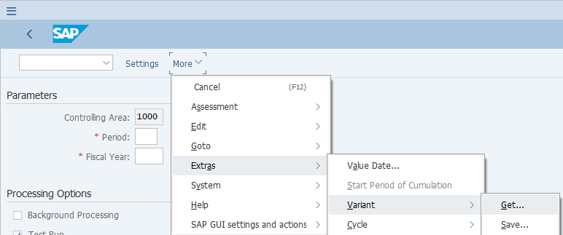
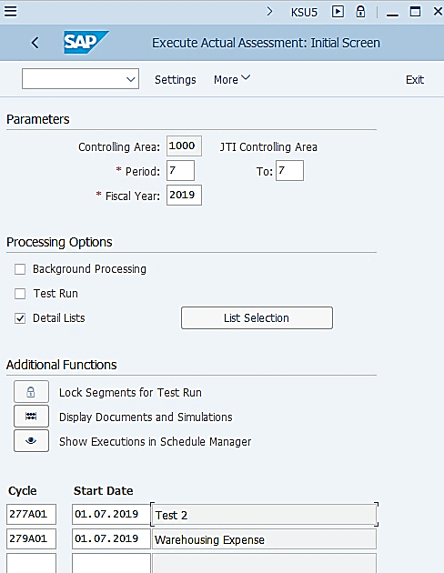
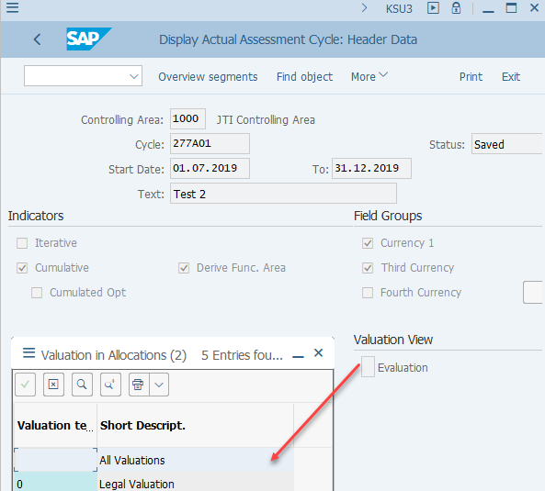
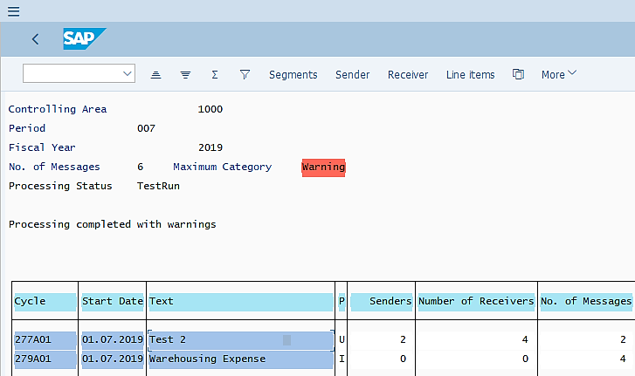
Cost Center Allocation: Assessment
KSU5: Cost Center Assessment Execution
KSU3: Display Assessment Cycle
Cost Center Assessment (KSU5) :
If you need to run Cost Center Assessment cycles outside of FCC, make sure you use the corresponding variant as indicated in the corresponding FCC task.
The variants are updated by GBS/JTBC when there are such requests from entities.
Cycles with the same allocation type (Distribution or Assessment), cumulative indicator (Cumulative indicator set or not set) and valuation view (indicating the posting to which ledger) settings are included in the same variant.
KSU5 output upon execution
In the master data of each cost center allocation cycle, the “Valuation View” indicates in which ledger the cycle is going to be run. For further details refer to Cost Management course.
It is recommended that you Test Run the cycle first if you are doing it outside of FCC so that you can review the messages and make amendments if needed before update run. You may display the segments/sender/receiver details using the corresponding buttons.
When you do an update run you will be provided with the posted document numbers for cycles with no errors in the output log (same as what you will find in an executed FCC task).

Slide 8
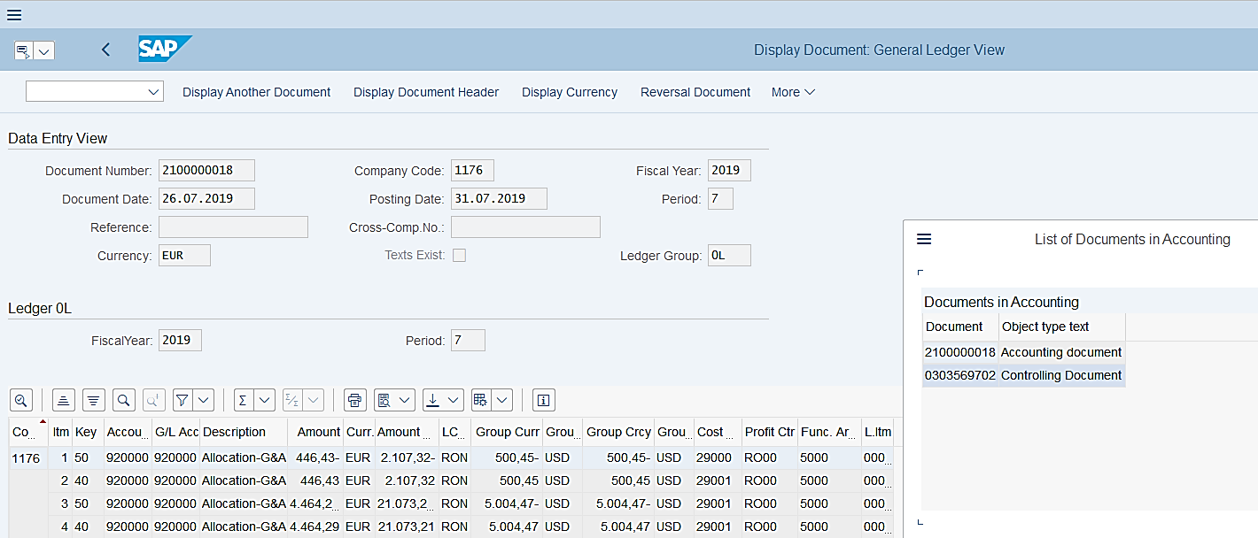
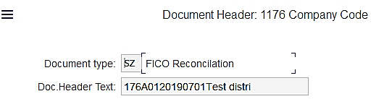
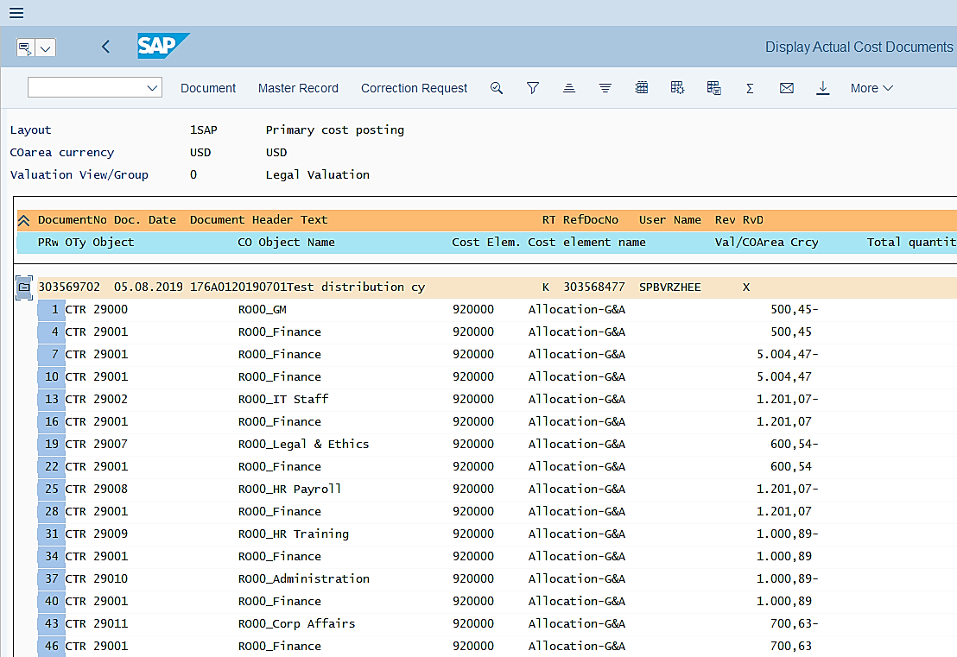
Cost Center Assessment: Posting Example
FB03 / FB03L
KSB5
Accounting documents generated from Cost Center Assessment postings have the same features as the documents generated from Cost Center Distribution postings, with the exception that the G/L accounts used in posting are not the original expense accounts. These are secondary cost elements, e.g. 920000.
In this example, you can see from the “List of Documents in Accounting”, that there’s only one FI document generated, which is the one posted to ledger 0L as shown. This is determined in the “Valuation View” in this specific cost center assessment cycle.

Slide 9
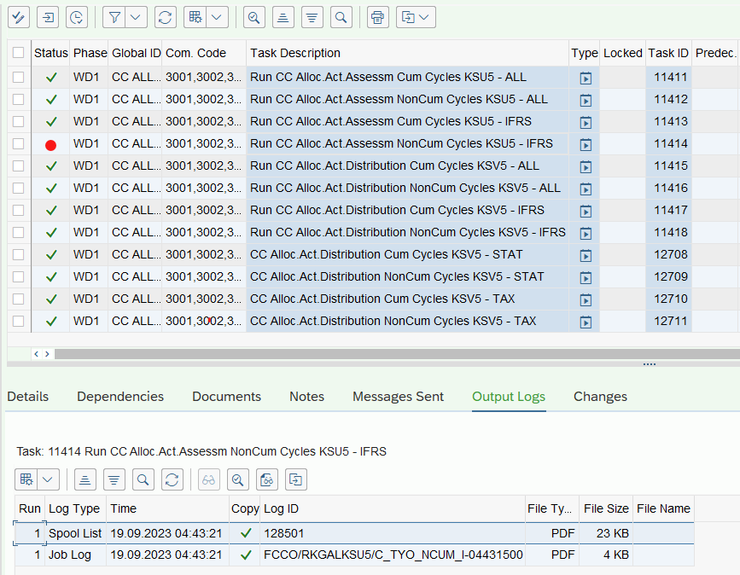
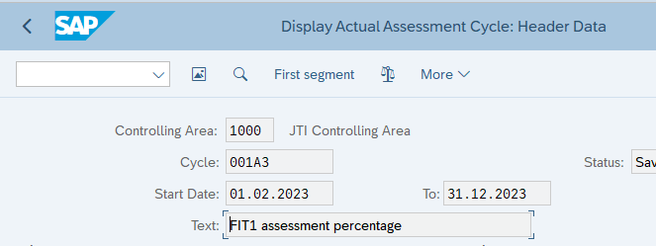
Cost Center Allocations – Common Errors
If the FCC task returns with an error status, you may check the details of the errors also on the “Output Logs” tab, by displaying the Spool List and Job Log. Usually the Spool List will explain what the errors are.
KSU3
The below common errors and solutions are not specific for KSU5/KSV5 FCC execution, but also when you manually execute KSU5/KSV5.
KSU5/KSV5 Transaction Common Errors | Error Reason | Error Resolution
Cycle cannot be processed: xxxxxx 01.01.2018(xxxx) | The cycle is probably old/not updated/not valid anymore | Check the dates to ensure that cycle is not outdated via KSV3 or KSU3 transaction
No valid sender entries were found | No valid cycle or empty | This is a warning, change the status to checked
The segment does not contain any senders | No valid cycle or empty | This is a warning, change the status to checked

